Slide 1



IST 659 Final Project
Harmony Hub (Music Streaming Service)
Seamless Sounds for Every Moment
Shashank, Guda
Vishnu, Charugundla
Prathyusha, Murala
Nikitha, Chandana

Slide 2

Project overview
The primary objective of Harmony Hub is to establish a robust database infrastructure that efficiently stores and organizes data pertaining to tracks, artists, streaming history etc.
IST-659 Final Project – 4th Dec 2023

Slide 3

Contents
Entity Relationship Data Requirements
Conceptual Data Model
Logical Data Model
Streaming Analysis
Creating Procedures
IST-659 Final Project – 4th Dec 2023

Slide 4

Goals
Facilitate a comprehensive understanding of user preferences, popular artists, and trending songs across various states of the USA
Ensure effective management of user and artist accounts, prioritizing security and data integrity.
Maintain the tracks table by consistently incorporating new songs and systematically eliminating outdated entries for sustained accuracy and relevance.
IST-659 Final Project – 4th Dec 2023

Slide 5
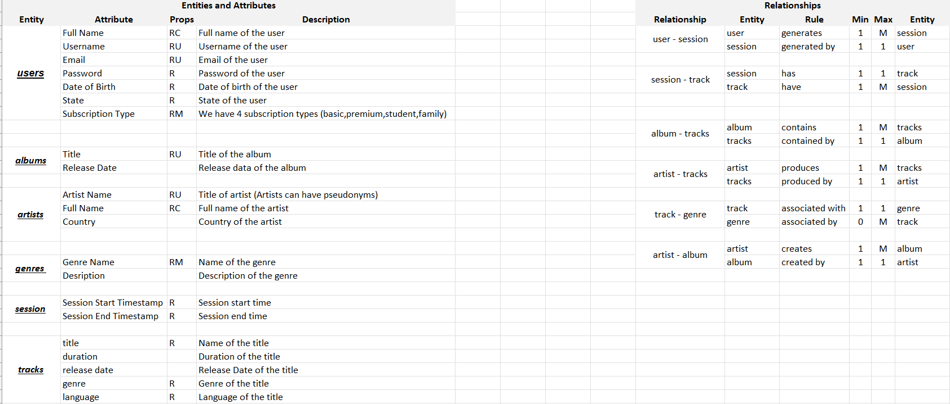
ER – Data Requirements
IST-659 Final Project – 4th Dec 2023

Slide 6
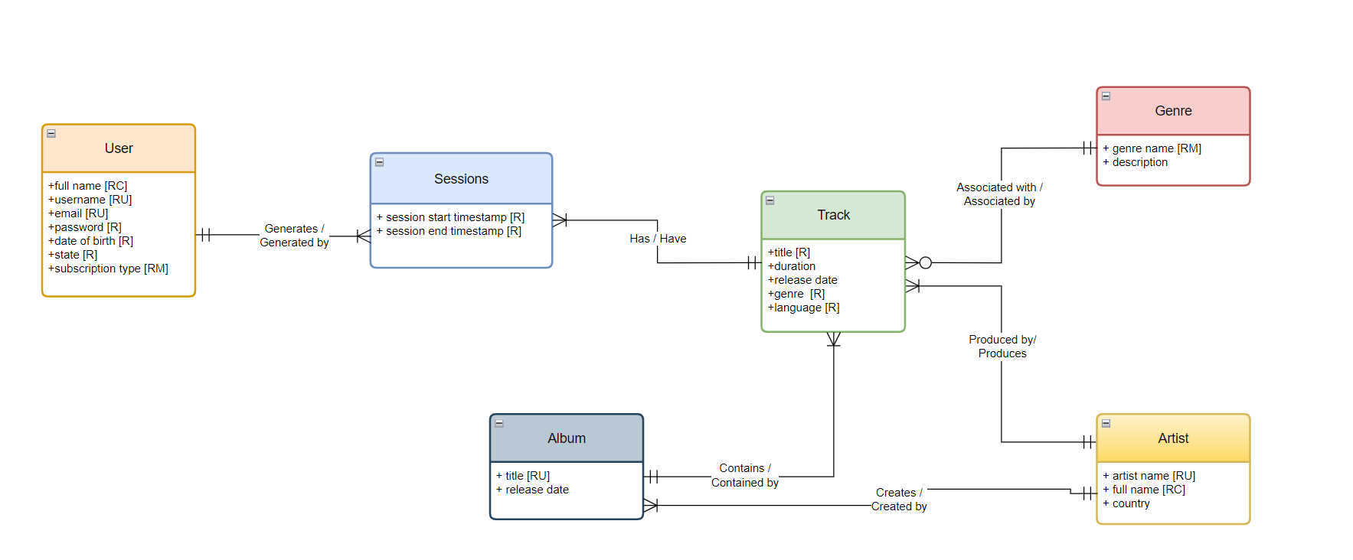
Conceptual Diagram
IST-659 Final Project – 4th Dec 2023
Notes:
This conceptual diagram is a high-level representation that captures the essential entities and relationships within our system.

Slide 7
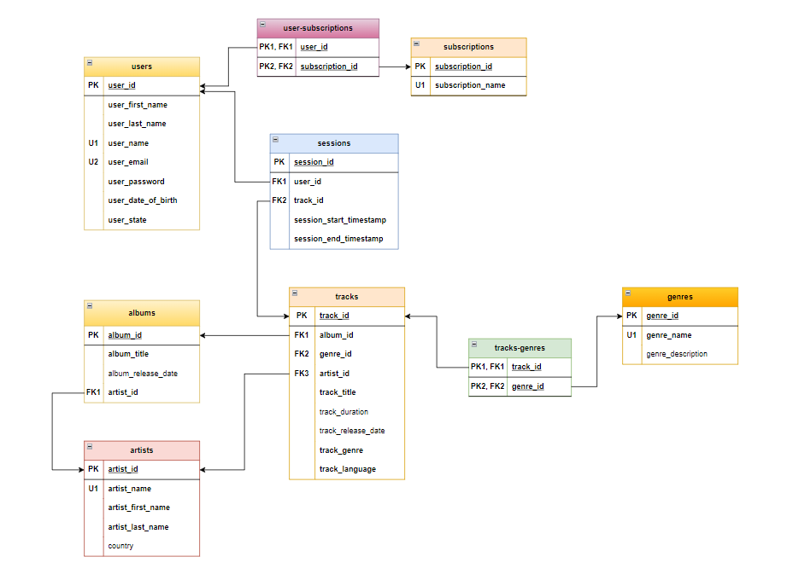
Logical Diagram
IST-659 Final Project – 4th Dec 2023
Notes:
Now, let's shift our focus to the logical diagram of our database. The logical diagram takes the concepts from the conceptual diagram and transforms them into a more detailed blueprint, outlining the tables, fields, and relationships that will be implemented in the actual database.

Slide 8
Data Creation
We’ve created the following tables using CREATE query & inserted data using INSERT query:
Tracks
Artists
Albums
Users
Subscriptions
Users_Subscriptions
Sessions
Tracks_Genres
Genres
IST-659 Final Project – 4th Dec 2023

Slide 9
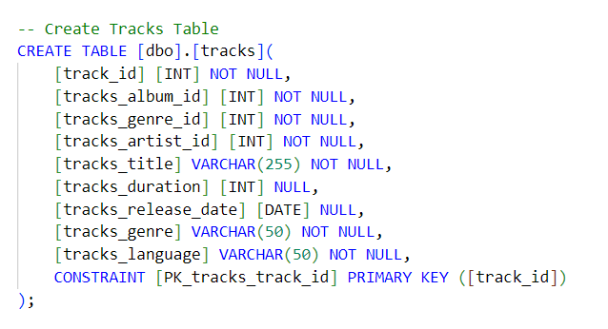
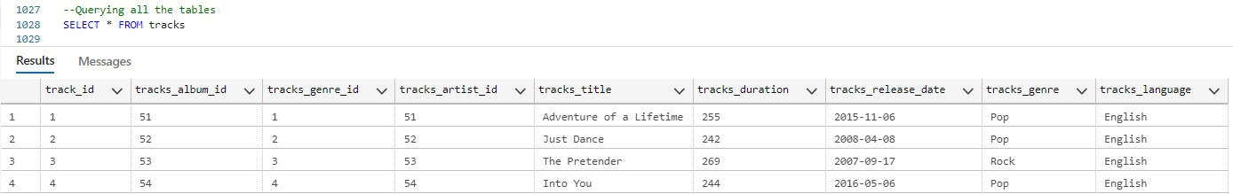
Tracks Table
IST-659 Final Project – 4th Dec 2023

Slide 10
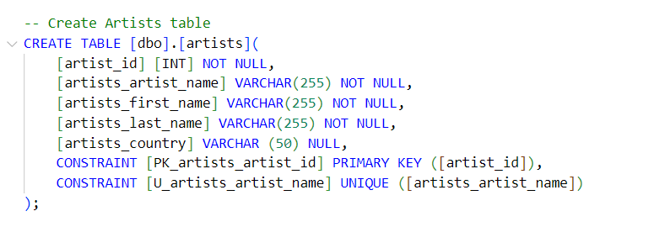
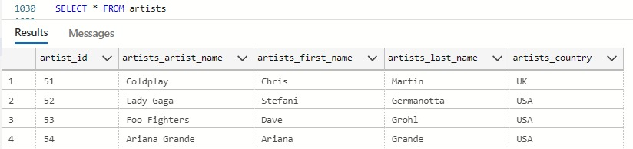
Artists Table
IST-659 Final Project – 4th Dec 2023

Slide 11
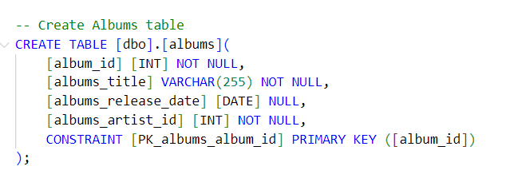
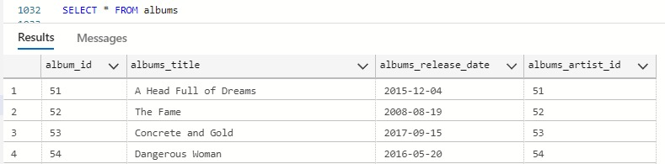
Albums Table
IST-659 Final Project – 4th Dec 2023

Slide 12
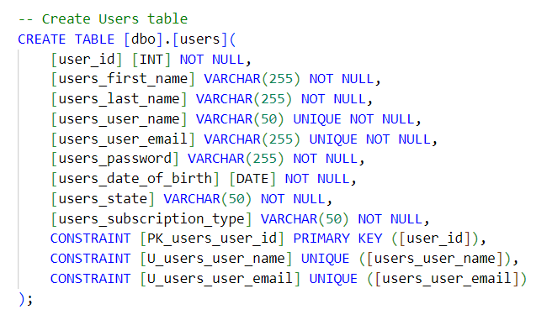
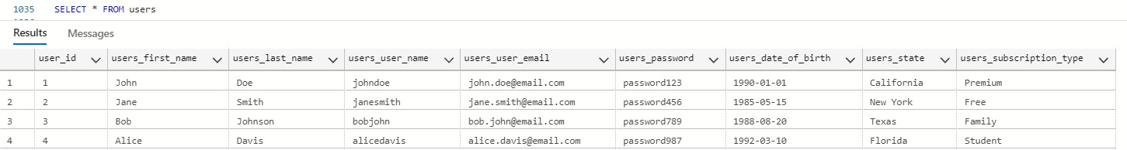
Users Table
IST-659 Final Project – 4th Dec 2023

Slide 13
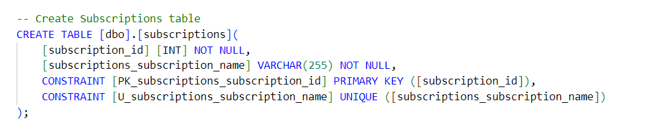
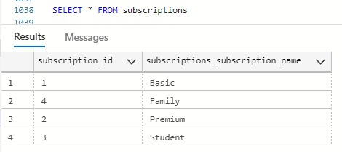
Subscriptions Table
IST-659 Final Project – 4th Dec 2023

Slide 14
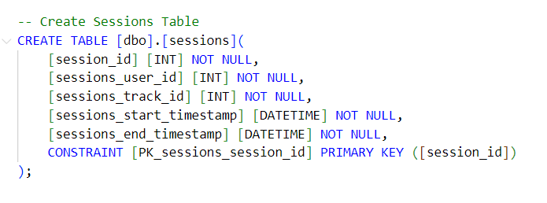
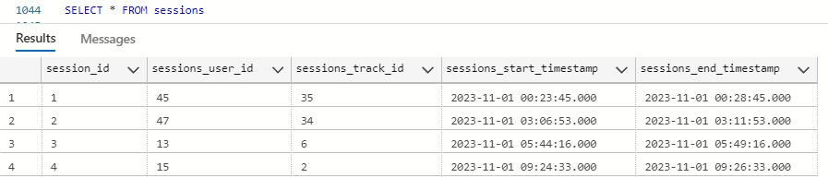
Sessions Table
IST-659 Final Project – 4th Dec 2023

Slide 15
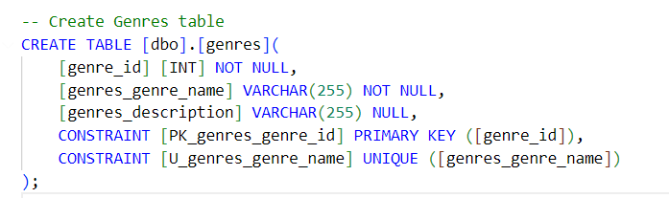
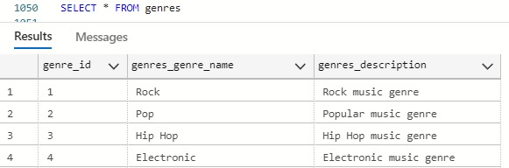
Genres Table
IST-659 Final Project – 4th Dec 2023

Slide 16
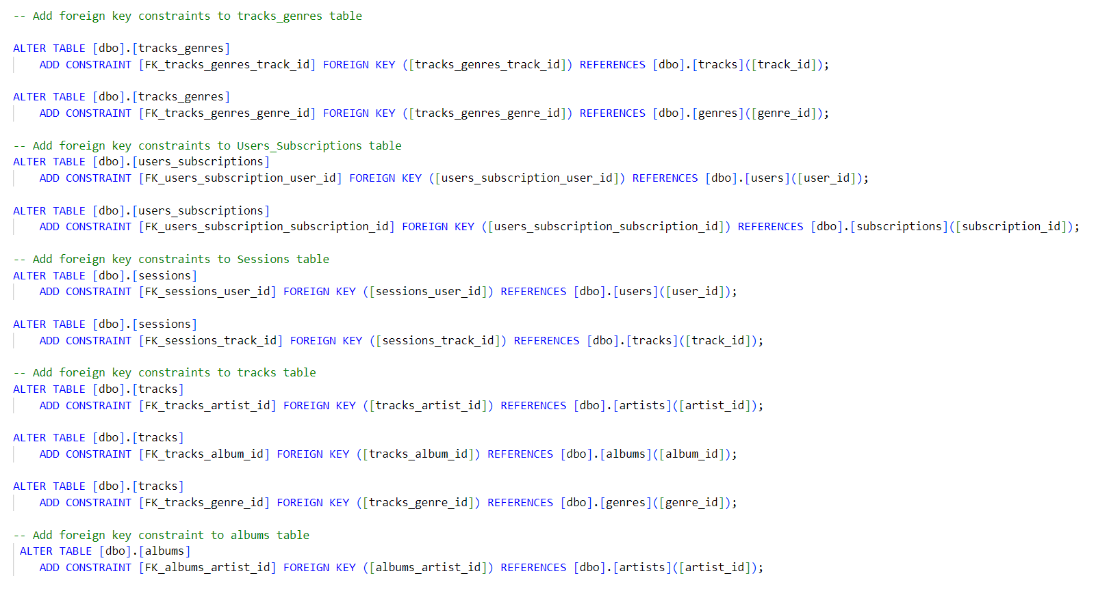
Foreign Key Constraints
IST-659 Final Project – 4th Dec 2023

Slide 17
Streaming Analytics
The project captures user listening habits, offering valuable insights into streaming data.
Enables analysis for artists, music companies, and project stakeholders to understand user behavior.
Essential information derived from the database aids artists, music companies, and Harmony Hub in making informed decisions.
Enables spotting trends, identifying popular songs, and refining strategies based on real-time data.
IST-659 Final Project – 4th Dec 2023

Slide 18
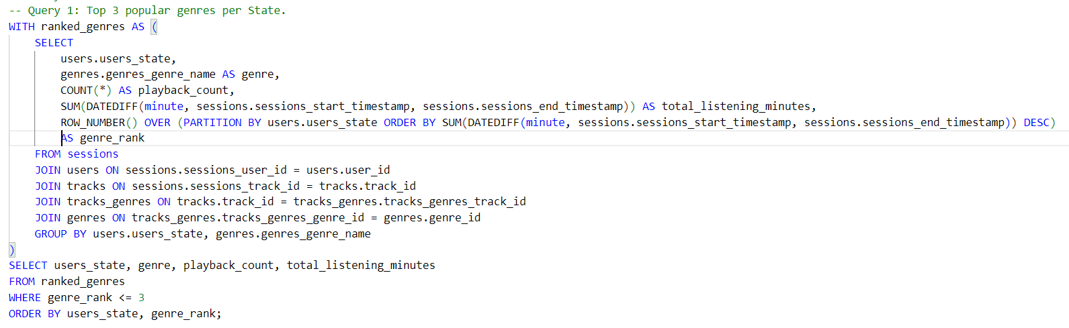
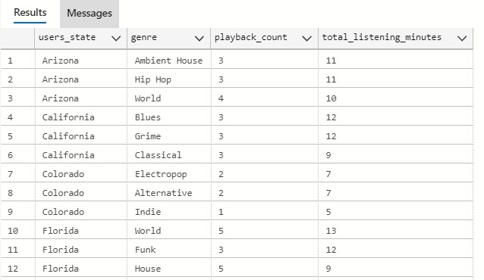
Analysis
Top 3 popular genres per State.
Query
Output
IST-659 Final Project – 4th Dec 2023
Notes:
### SQL Query 1: Most Popular Genres Per State.
### Insight from the Query:
This query provides a state-wise breakdown of the most popular music genres, measured by both the number of listening sessions and the total duration of listening. Such insights are extremely valuable for:
- **Music Streaming Services**: To tailor their playlists and recommendations based on regional preferences.
- **Artists and Record Labels**: To understand where their music (or specific genres) is most popular, guiding tour planning and marketing efforts.
- **Advertisers and Marketers**: To target their campaigns more effectively based on regional musical tastes.
For instance, if the query reveals that 'Ambient House' music is most popular in Arizona with the highest total listening minutes, while 'Blues' dominates in California, this indicates distinct cultural preferences that can be leveraged for targeted promotions or content curation.
SQL Concepts:
Common Table Expression (CTE) - ranked_genres:
This part of the query creates a temporary result set named ranked_genres.
The ROW_NUMBER() function is used to assign a rank to each genre within a specific state. The ranking is based on the total listening minutes in descending order.

Slide 19
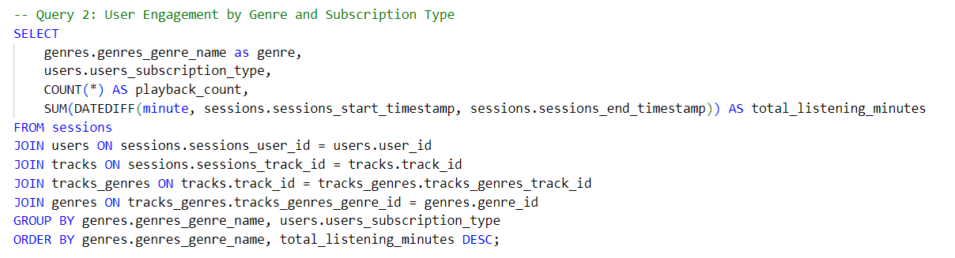
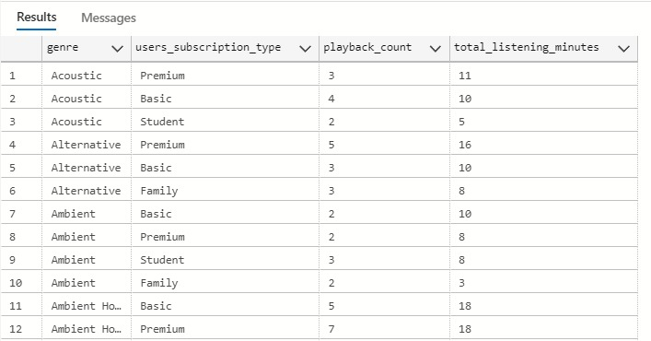
Analysis
User Engagement by Genre and Subscription Type
Query
Output
IST-659 Final Project – 4th Dec 2023
Notes:
This query aims to find out how different subscription types engage with various music genres. It's useful to understand if premium users favor certain genres over basic or student subscribers, which could inform marketing strategies.
#### Insight:
This query provides insights into how different subscriber groups engage with various music genres. For example, if premium subscribers are found to spend more time listening to classical music compared to other groups, the service could consider offering more premium classical music content or targeted promotions for classical music events.

Slide 20
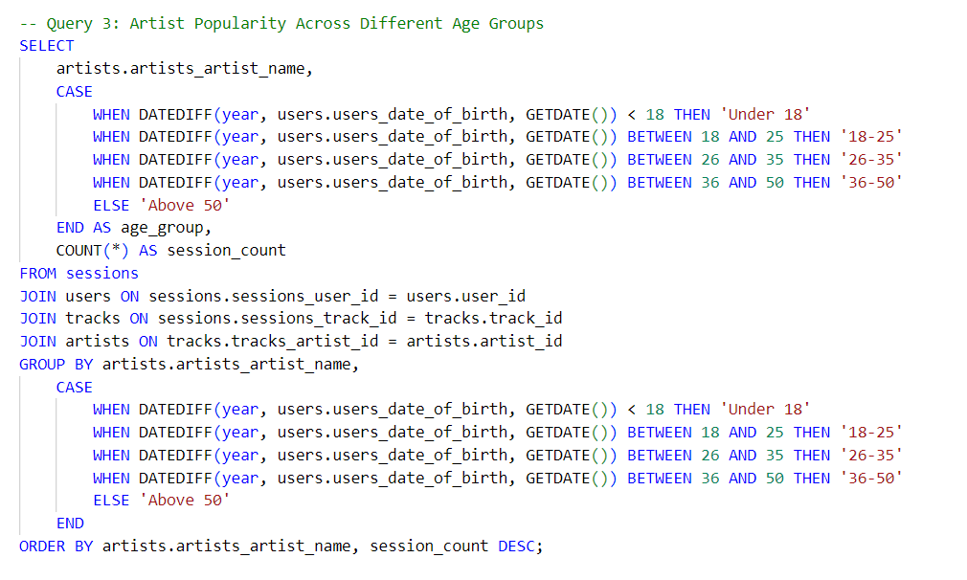
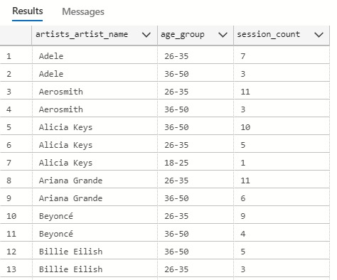
Analysis
Artist Popularity Across Different Age Groups
Query
Output
IST-659 Final Project – 4th Dec 2023
Notes:
This query is designed to analyze which artists are popular among different age groups, providing insights into generational music preferences.
#### Insight:
This query can reveal how artists' popularity varies across different age groups. For example, if a particular artist is predominantly popular among users under 18, it might suggest a younger fan base, while another artist popular with the 'Above 50' group would indicate a different appeal. This information is crucial for artists and record labels to tailor their marketing and outreach strategies to the right audience.

Slide 21
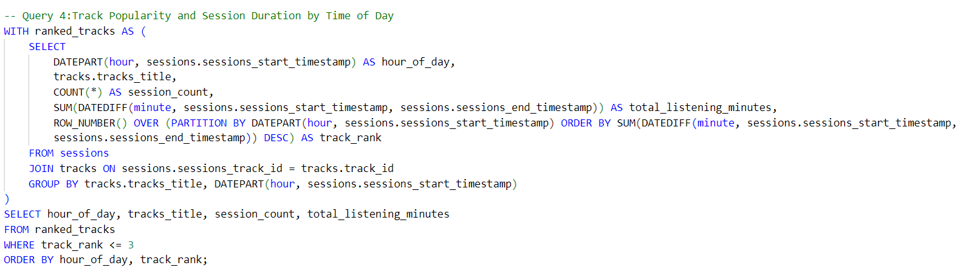
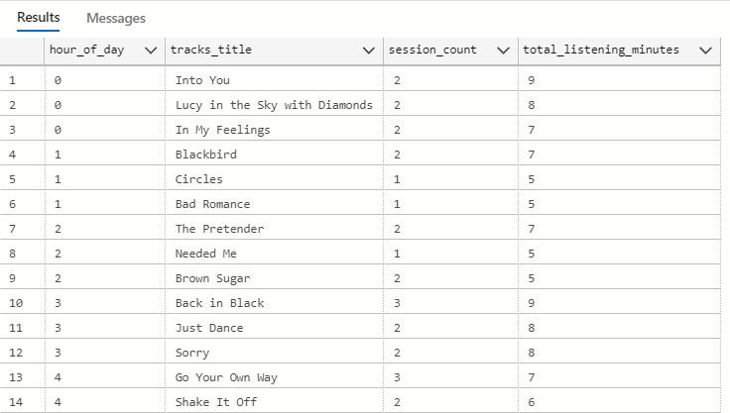
Analysis
Track Popularity and Session Duration by Time of Day
Query
Output
IST-659 Final Project – 4th Dec 2023
Notes:
This query aims to understand the popularity of tracks and the duration of listening sessions at different times of the day. It can provide insights into listening habits and preferences based on the time of day.
#### Insight:
This query helps to identify which tracks are most popular during specific hours of the day and how long users listen to them. For example, if certain tracks are more popular in the evening, it might indicate a preference for relaxing or upbeat music to unwind after work.

Slide 22
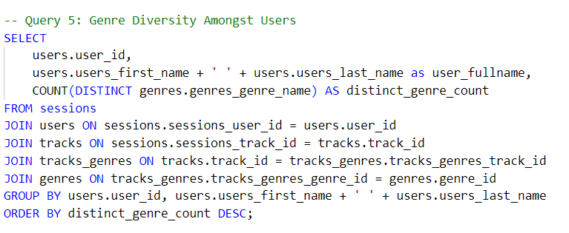
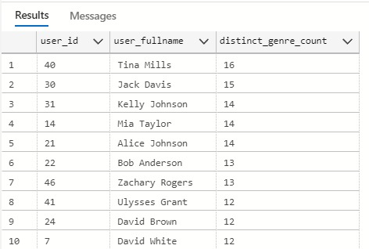
Analysis
Genre Diversity Amongst Users
Query
Output
IST-659 Final Project – 4th Dec 2023
Notes:
This query is aimed at understanding the diversity of music genres listened to by individual users, which can inform recommendations and user engagement strategies.
#### Insight:
This query determines the diversity of music genres each user listens to. A higher distinct genre count for a user indicates a wide range of music interests, which can be useful for creating more personalized and varied music recommendations. For instance, users with a high genre diversity might appreciate a more eclectic mix of tracks in their recommendations.
Both of these (4,5) queries provide unique insights into user behavior and preferences, which are essential for any music streaming service aiming to enhance user experience and engagement.

Slide 23
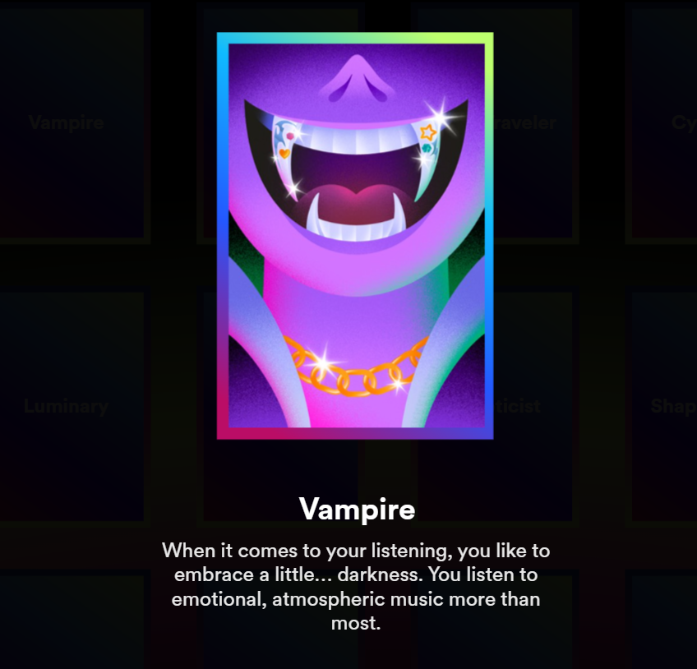
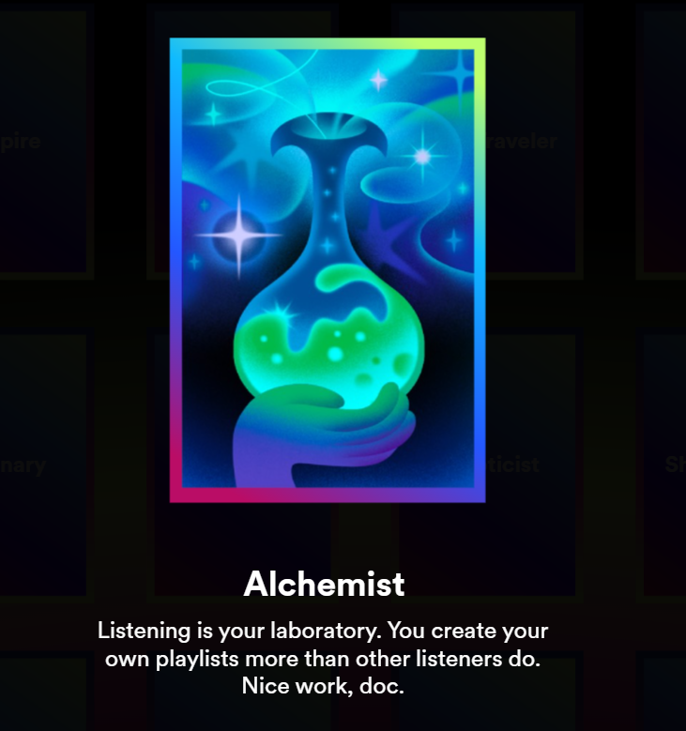
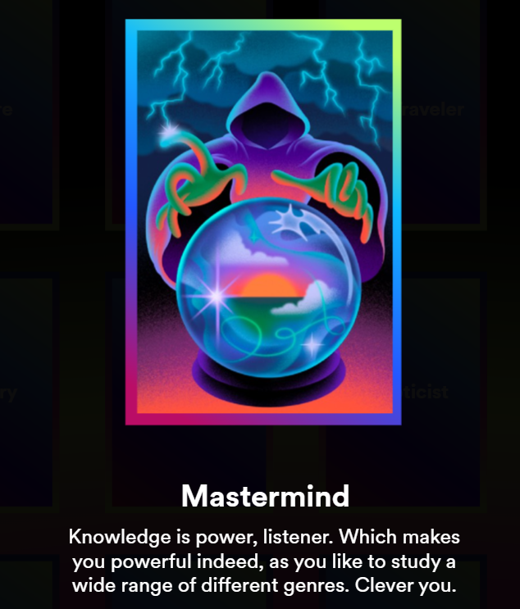
Analysis
Fun Fact: Leveraging user data analytics, Spotify implemented a targeted user engagement program. By analyzing streaming patterns across genres, they identified segments of high-affinity users to highlight with relevant badges reflecting musical preferences.
Source: https://newsroom.spotify.com/2023-11-29/me-in-2023-streaming-habits-wrapped/
IST-659 Final Project – 4th Dec 2023

Slide 24
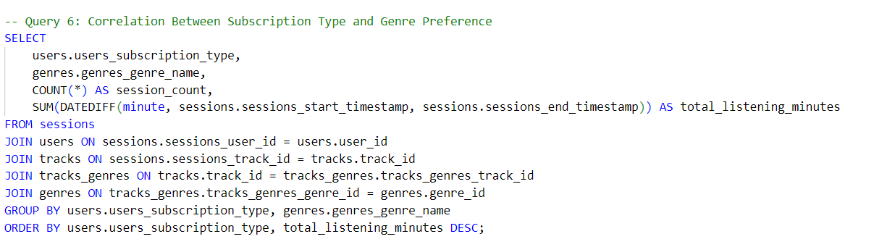
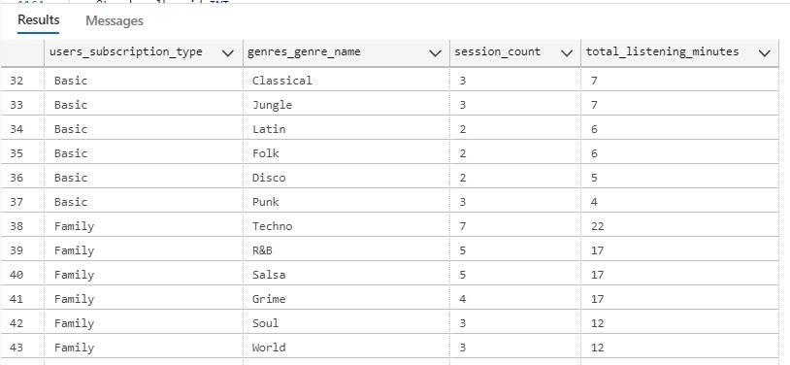
Analysis
Correlation Between Subscription Type and Genre Preference
Query
Output
IST-659 Final Project – 4th Dec 2023
Notes:
This query aims to find correlations between subscription types and the preferred music genres. This can help in understanding the content preferences of different subscriber categories.
#### Insight:
This query can reveal if there's a trend in genre preferences among different subscription types. For example, if premium subscribers predominantly listen to certain genres more than basic subscribers, it could indicate a higher willingness to pay for specific types of content. This insight can be crucial for subscription-based business models, guiding content acquisition and marketing strategies.
Query offers strategic insights that can guide business decisions, marketing strategies, and content curation in the context of a music streaming service.

Slide 25
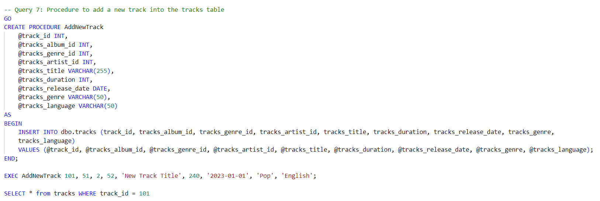
Procedure 1
Procedure to add a new track into the tracks table
Query
Output
IST-659 Final Project – 4th Dec 2023

Slide 26
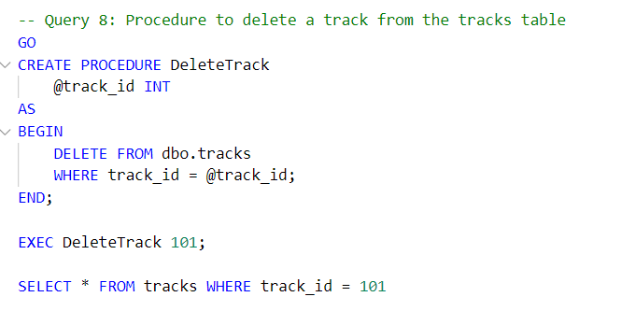
Procedure 2
Procedure to delete a track from the tracks table
Query
Output
IST-659 Final Project – 4th Dec 2023

Slide 27

Thank you,
Professor Jillian Lando

